Slide 1
How to Start the Command Prompt
To start the CMD Prompt
Click on the Star button
Enter the word CMD in the search box
Click on the CMD program
The command prompt should appear

Slide 2
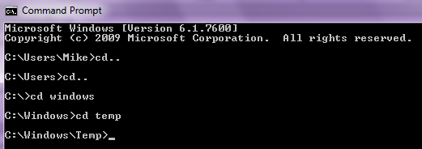
How to Navigate Between Folders
The first command you should be aware of is the CD command.
The command CD\ takes you to the top (root) of the directory tree
You should see the C: drive prompt
If you need to go to a specific directory you type CD directory name
CD windows\system32
CD.. Takes you one
directory back

Slide 3
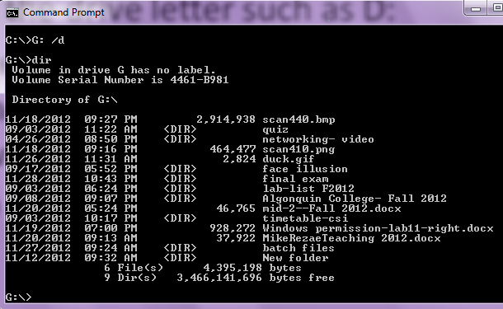
How to navigate between folders
To change to another drive such as a USB drive you type the drive letter such as D:
To change the drive and the directory at the same time, use the cd command followed by the /d switch
Try CD/D c:\windows

Slide 4
View the contents of a folder DIR
You can view the content of a folder by using a simple command called DIR

Slide 5
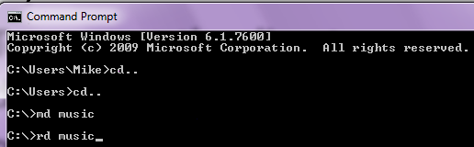
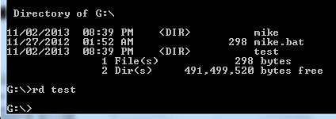
How to Create a New Folder (MKDIR)
You can make a new directory using the MKDir or the MD command
C:\MD Test
To remove the directory you have to not be in the directory
C:\RD music
RD= Remove Directory
G:\rd test

Slide 6
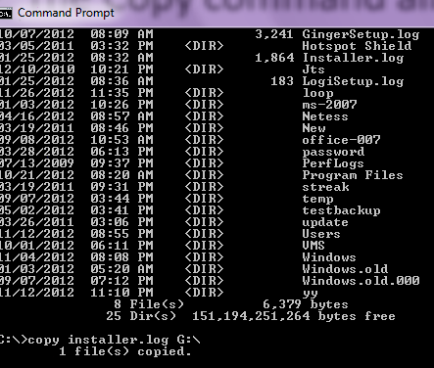
Copy Files and Folders
The Copy command allows you to copy files from one location to another. To use this command you have to type copy location\filename.extension location\newname.extension.
d:\7tutorials\picture1.jpg d:\7tutorials\7tutorials_tests\testing_picture1.gif
If you are copying within the same directory you
don't have to put the path
in command.

Slide 7
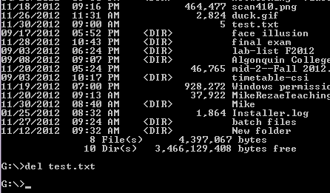
Deleting Files & Folders (del)
The Del command is used to delete files within the directories you’ve created.
Use the /h switch when deleting hidden files
Be careful when deleting hidden files as most system files are hidden by default
To delete a single file the command would be del test.txt [enter]

Slide 8
Launch a program
To run a program from the Command Prompt, you need only to navigate to the directory that contains the executable and simply type in the program name.
For example, if we want to launch Paint using Command Line, we have to go to C:\Windows\System32 and there we will find the executable called mspaint.exe.

Slide 9
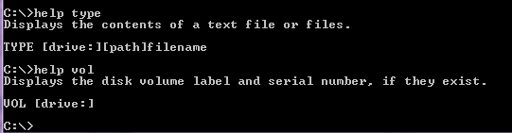
Help
To access help in Command Prompt you just have to type the help command and then press Enter.
If a certain command interests you type help followed by the name of the command. Another way to do the same thing is to type command_name followed by the /? parameter. To test, use help cd or cd/?

Slide 10
Batch Files
Batch files are used to automate everyday tasks such as helping a computer technician diagnose a networking issue or shorten the time it takes to everyday tasks such as compile Java programs.

Slide 11
Batch File Commands
ECHO - the “print ” statement for BAT files. Anything following the word ECHO will be displayed in the command prompt as text, on its own line.
ECHO OFF – BAT writers typically put this at the beginning of their files. It means that the program won’t show the command that you told it to run while it’s running – it’ll just run the command.
'@echo OFF' will turn off all line echoes in the batch file script, until 'echo ON' is encountered

Slide 12
Batch File Commands
PAUSE - This outputs the “press any key to continue…” message that you’ve seen all too many times. It’s helpful because it pauses the batch file execution. If you don’t put this in your program, everything will speed by and end before you can see it. Programmers typically put this in batch files to give the user a chance to review the material on the screen before continuing.

Slide 13
Batch file Commands
CLS - Clears the CMD window
SET – Sets a variable. If you want to see what the content of a variable, use the echo command. With the /p switch you can instruct set to create a new variable based on the users input.
C:\Windows\System32>set foo=1
C:\Windows\System32>echo %foo%
1

Slide 14
Batch file commands
IF – The IF command ties together batch processing. The IF command responds to the variable created by the set command.
If /i – extracts the first letter typed
GOTO – The GOTO command tells the command prompt to jump to a new location in the batch file.

Slide 15
% and %% sign
The percent sign is used in batch files to represent command line parameters: %1, %2, ...
Two percent signs with any characters in between them are interpreted as a variable:
echo %myvar%
Two percent signs without anything in between (in a batch file) are treated like a single percent sign in a command (not a batch file): %%f

Slide 16
== double equals
== ] (Double Equals) The "IF" command uses this to test if two strings are equal: IF "%1" == "" GOTO HELP

Slide 17
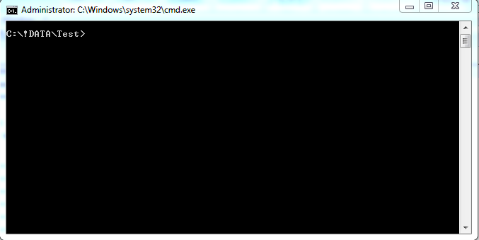
Command Prompt
The command shell can also execute command statements sequentially in the form of a batch job.
The shell will interpret a file as a batch job with the .bat file extension.
The Command Line Interpreter

Slide 18
Command Prompt
To interact with the shell you need commands.
Commands are programs that may be built-in (Internal )meaning they are a part of the shell itself. (echo, cd, copy, dir)
OR
Commands are external programs which the shell can execute and return text output. (ping, tracert, robocopy)
OR
Commands are external programs which the shell can execute and return a Graphical User Interface (GUI). (calc, notepad, perfmon, diskmgmt)

Slide 19
Command Syntax
Syntax is the set of rules governing the construction of a command line.
Command line syntax has many parts but since this is an introduction only the basic syntax is given here.
Command – the program being run by the Command Line Interpreter (CLI)
Options – a special argument to the command that changes the behavior of the command.
Arguments – a parameter the command will act upon. Arguments may be options, variables, source/destination files/folders etc.

Slide 20
Command Syntax
Ping –t 127.0.0.1
Command
Options
Argument

Slide 21
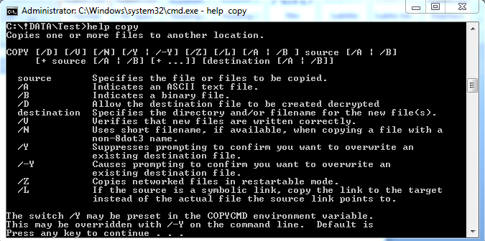
Shell Commands
help – Help is a built-in that calls the manual page for a particular command. The help command has one argument – a command name.
i.e. Help copy

Slide 22
Shell Commands
exit – exit is a built-in that ends the current interactive shell or terminates a batch process. Exit has no arguments
CTRL C – also written as ^C. Pressing the control key and the c key at the same time will terminate the shell’s current running process. Sometimes this interrupt is necessary to return your shell prompt.
ie. Ping –t 127.0.0.1
cls – clears the terminal window. Very useful for tiding up a messy or cluttered terminal window.

Slide 23
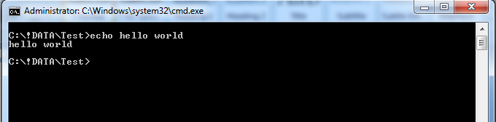
Shell Commands
Echo – echo is a built-in that outputs the input text string back to the shell.
i.e. Echo hello world
@echo off – Prevents commands from being echoed to the screen during batch processing. Usually the first line in any batch scripts.

Slide 24
Shell Commands
copy – copy is a built-in that duplicates files or folders from a source to a destination.
xcopy – similar to copy with more options for copying files and folders
robocopy – Robust copy. An even more advanced form of copy that has many options.
Move – similar to the cut and paste functionality found in the Windows GUI.

Slide 25
Shell Commands
Time – allows the user to set the system time. Can be used in the form time /T to simply report the current time.
Date – similar to time date allows the user to set the system date. Can be used in the form date /T to simply report the current date.
Dir – reports the directory structure can be used with the options:
/b – bare format
/s – include subdirectories
/p – paginate the output

Slide 26
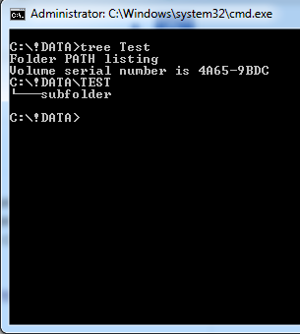
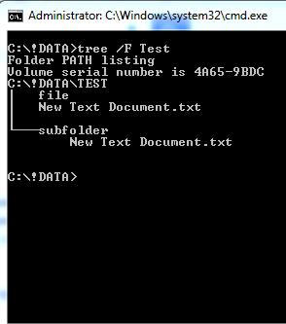
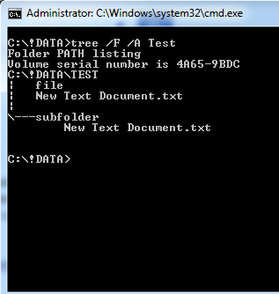
Shell Commands
Tree – tree is a command to produce a hierarchical diagram of the directory structure. Can be used with the options:
/F – include files and directories in the output.
/A – use ASCII art rather than a graphical representation.
Tree – files and ASCII option
Tree – no options
Tree – files option

Slide 27
Shell Commands
Ipconfig – Displays the current configuration for the Network Interface Cards (NIC) in the system. Ipconfig has options:
/all – displays a long listing for the NIC’s
/release – remove the current ip address for the NIC
/renew – acquire a new IP address from DHCP
/flushdns – clears the DNS entries from the local DNS record
Ping – icmp echo request to a target system. Often used to see if a particular system or NIC is up.
Tracert – reports a table to a destination system hop by hop. Useful in diagnosing network issues.

Slide 28
Batch Commands
@ECHO OFF – prevents the terminal from displaying all the commands executed during the script operation.
Pause – halts the script from continuing until the user has pressed a key
REM – used to comment the shell script
Call – used to start another batch process. The shell will wait for an exit code from the spawned shell before continuing.
Set – sets a variable to a certain value. Set has options:
/A – arithmetic expression
/P – prompt the for user input

Slide 29
Batch Commands
Variables can be recalled by using the variable names within percent signs
Echo %time%
For delayed expansion of variables place the variable name inside exclamation marks.
set VAR=before if "%VAR%" == "before" ( set VAR=after if "!VAR!" == "after" @echo If you see this, it worked )

Slide 30
Batch Commands
IF <condition> == <statement> (
Do something
) Else if <condition> == <statement> (
Do something else
) else (
Do something finally
)
IF %string1% == %string2% (
echo “The strings match”
)

